Slide 1


Artificial Intelligence(AI101B)
Analyzing website traffic data
PRESENTED BY-
Mahima Goyal
Khushi Jain
Harsh Gupta
202410116100112
202410116100100
202410116100082
PRESENTED TO-
Mr. Apoorv Jain (Assistant Professor)

Slide 2



02
Problem Statement
In the digital era, businesses rely heavily on website traffic to measure online engagement, customer behavior, and conversion rates. However, raw traffic data is vast and complex, making it difficult to derive actionable insights manually. The challenge is to develop an AI-driven system that can analyze website traffic data, identify patterns, detect anomalies, and predict future trends.

Slide 3



Objective
Collect and preprocess website traffic data.
Use AI models to analyze user behavior and engagement patterns.
Identify peak traffic times, bounce rates, and conversion funnels.
Detect anomalies such as traffic spikes or bot activity.
03

Slide 4



04
Methodology
Data Collection
Preprocessing
Data Vizualization
Gather relevant data from diverse sources.
Clean, normalize, and engineer data.
Compare multiple AI models to determine the most accurate and efficient one.

Slide 5


05
Data Collection and Preprocessing
We gather relevant datasets from various sources and clean, normalize, and preprocess the data to ensure its quality and consistency. This step is crucial for training accurate and reliable AI models. Such as Convert timestamps into useful features such as time of day, day of the week, and seasonal trends.

Slide 6


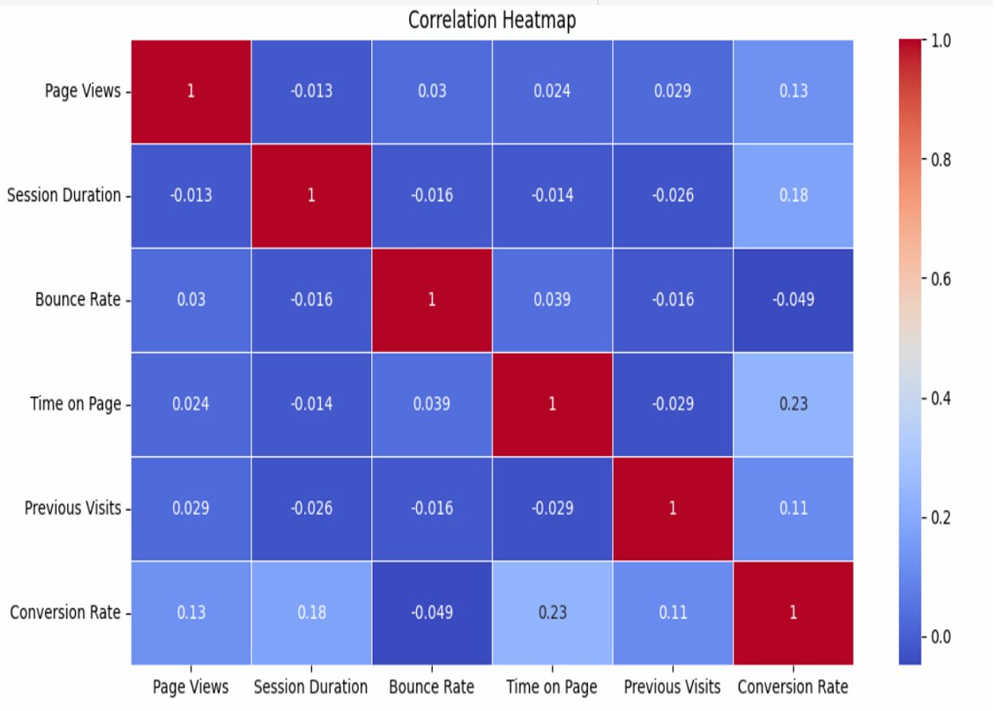
Result and Impact
08

Slide 7
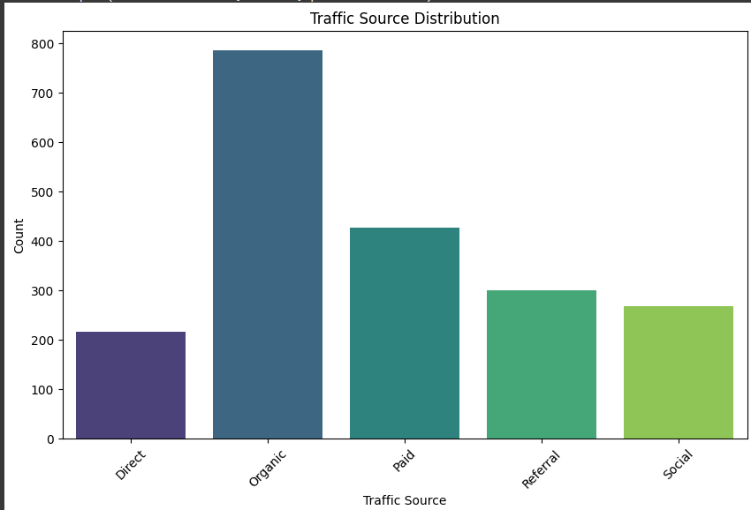
Result and Impact
08

Slide 8



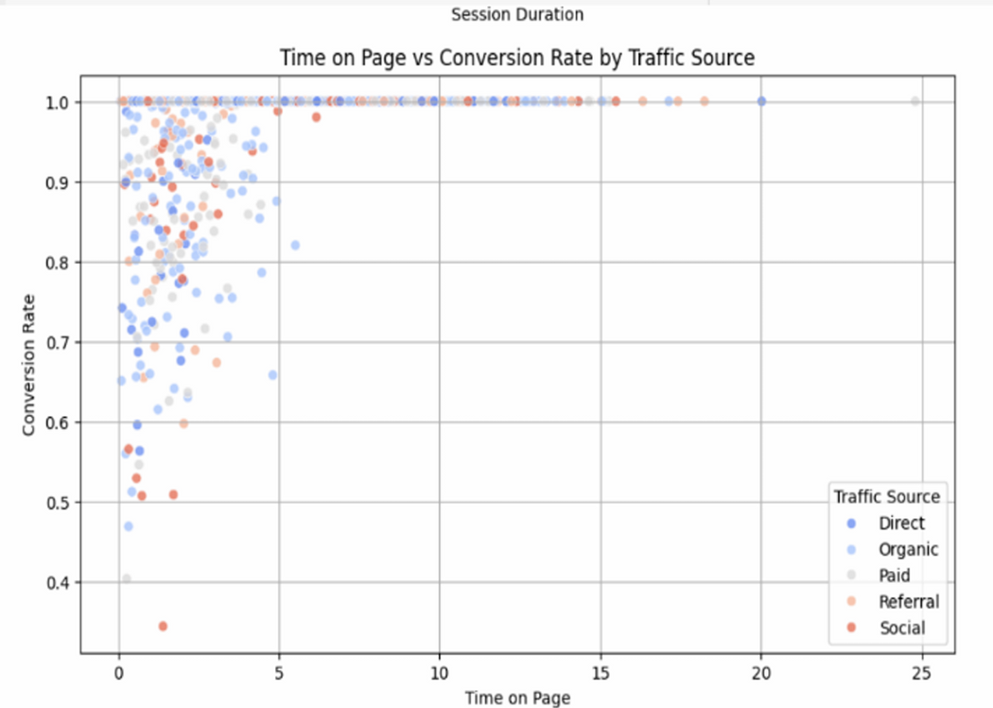
06
Result and Impact

Slide 9



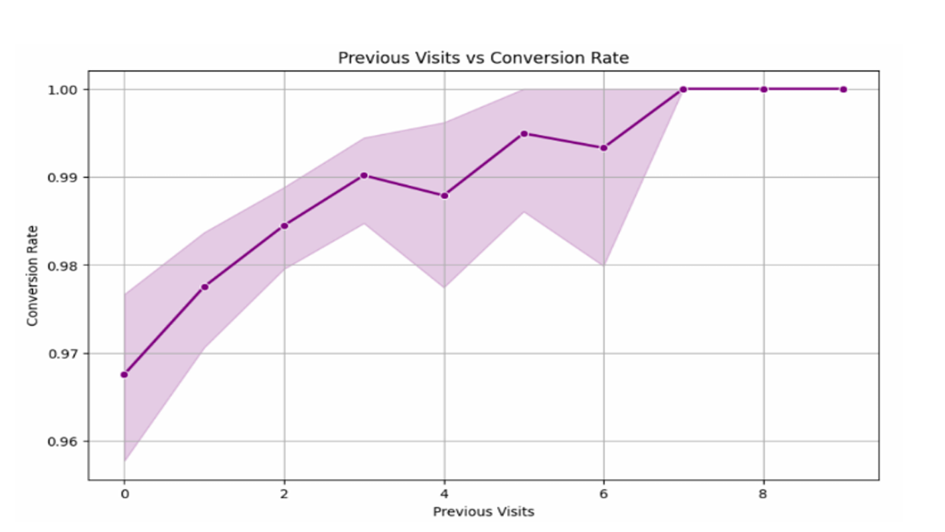
07
Result and Impact

Slide 10


Insights
Websites receiving traffic from organic sources showed higher engagement and conversion rates.
Short session durations and high bounce rates negatively impacted conversions.
Returning visitors had a significantly higher likelihood of converting compared to first-time visitors.
Users spending more time on pages were more likely to convert, indicating that engaging content improves conversion rates.

Slide 11
Recommendation
Based on the findings, the following recommendations were made:
Improve landing page engagement to reduce bounce rates.
Optimize content and UI to increase session duration.
Implement retargeting strategies for returning visitors to boost conversions.
Enhance SEO efforts to maximize organic traffic acquisition

Slide 12



Thank You!

